Slide 1




Mixture of Ordered Scoring Experts for Cross-prompt Essay Trait Scoring
Po-Kai Chen⁺, Bo-Wei Tsai⁺, Kuan-Wei Shao★, Chien-Yao Wang♪, Jia-Ching Wang⁺, and Yi-Ting Huang★
National Taiwan University of Science and Technology★, Academia Sinica♪, National Central University⁺
Notes:
Hi everyone, I am going to present our work
“Mixture of Ordered Scoring Experts
for Cross-prompt Essay Trait Scoring”

Slide 2


Task definition
Cross-prompt essay scoring
Cross-prompt essay trait scoring
Essay scoring
Holistic Score
Content
organization
Holistic Score
Holistic Score
…
Essay Scoring
Essay Scoring
Essay Scoring
train
test
train
test
train
test
Seen Prompt & Essay
Seen Prompt
& Essay
Unseen Prompt
& Essay
Seen Prompt
& Essay
Unseen Prompt
& Essay
(Taghipour and Ng, 2016;Dong and Zhang, 2016; Yang et al., 2020; Wanget al., 2022)
(Jin et al., 2018; Li et al., 2020; Ridley et al., 2020)
(Ridley et al., 2021; Chenand Li, 2023; Do et al., 2023; Xu et al., 2025)
Our work focuses on cross-prompt essay trait scoring.
Notes:
let me define our task First, .
Essay scoring means that,
given an essay, the system outputs a holistic score to measure its overall quality.
Earlier approaches typically followed a prompt-specific training scheme
That is, they trained a separate model for each essay prompt.
When faced with an unseen prompt, these models often failed to generalize.
To address this limitation, cross-prompt essay scoring aims to
develop a more generalized approach
That performs well
especially on unseen prompts.
However, these studies focus on predicting a score
That is one number as an output.
But, in real educational settings, teachers and students need feedback on multiple dimensions of writing
So, recent research has started to focus on multi-trait scoring.
In this setting, the system outputs not just a number, but also trait-specific scores,
such as content, organization, and grammar.
Building on this foundation, our work focuses on cross-prompt multi-trait essay scoring.

Slide 3
Motivation
Previous work like PAES (Ridleyet al., 2020)
Consider only essay as input.
Focus on the essay quality and ignoring prompt adherence.
SOTA: ProTACT (Do et al., 2023)
Use LDA to extract essay-prompt correlation.
Rely solely on syntactic features for essay representation.
They overlook content-level features in both prompts and essays, such as semantic and linguistic information.
They develops ONE single model to evaluate multiple traits, failing to capture different perspectives specific to each trait.
Notes:
Let’s look at the motivation behind our work.
Some previous work like PAES 壞阿斯 only considers essays as input
The assessment focus on the essay quality
And ignore prompt adherence
even though ProTACT Use LDA to extract essay-prompt correlation.
they only use part-of-speech to represent essay.
These work overlook t content-level features in both prompts and essays
Moreover, they develops ONE single model to evaluate multiple traits
It fails to capture different perspectives
specific to each trait.

Slide 4
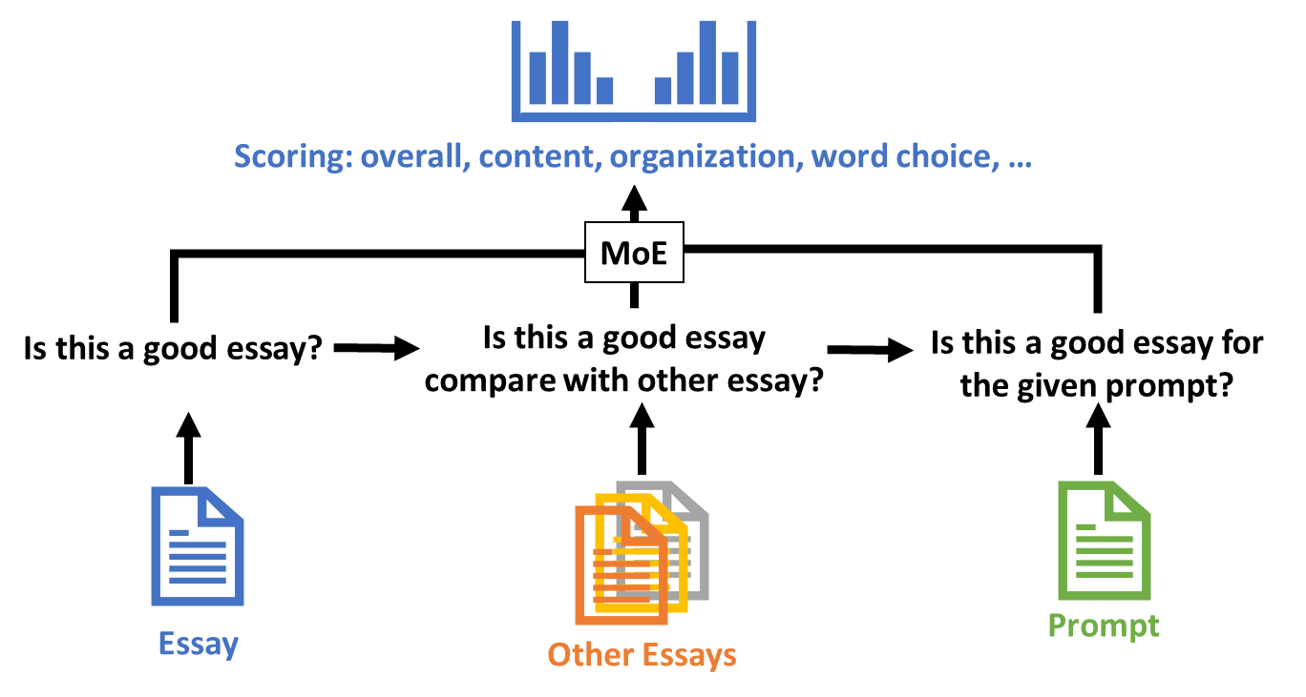
Research purpose
In this work, we propose MOOSE (Mixture of Ordered Scoring Experts) framework for cross-prompt essay trait scoring.
Ordered Scorer Experts (OSE): designs three experts to imitate the reasoning process of a human rater.
Mixture of Experts (MoE): dynamically selects different scoring cues that are specific to each trait.
Notes:
In this work, we propose MOOSE (Mixture of Ordered Scoring Experts) framework for cross-prompt essay trait scoring.
It includes:
Ordered Scorer Experts (OSE): we designs three experts to imitate the reasoning process of a human rater.
(pointing to the figure) Given an essay, a rater might ask:
Is this a good essay?
Compared to other essays, is it better or worse?
Given the prompt, is this essay relevant?
Moreover, we include the Mixture of Experts (MoE) mechanism,
It dynamically selects different scoring cues that are specific to each trait.
It allows MOOSE
to adapt its scoring rubrics
based on
what matters most
for each trait.
OSE: 藉由模仿專家的評分過程
MoE: 因為每個trait 應該由不同專家來決定，應該要看重不同類型的特徵 (learning cue)

Slide 5
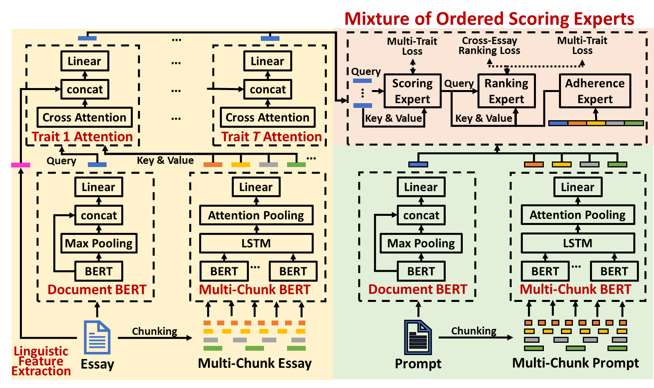
System overview
Notes:
This is the workflow of MOOSE.
When given an essay,
we use Document BERT and Multi-Chunk BERT to generate semantic embeddings at multiple granularities.
We also extract linguistic features such as readability and word usage as side information.
These representations are then used to compute trait-specific attention
one for each individual trait.
Similarly, document and mutli-chuck BERT also extract the prompt representation for later use.
Finally, both the trait-specific essay representations and the prompt embedding are fed into the MOOSE framework for scoring.

Slide 6
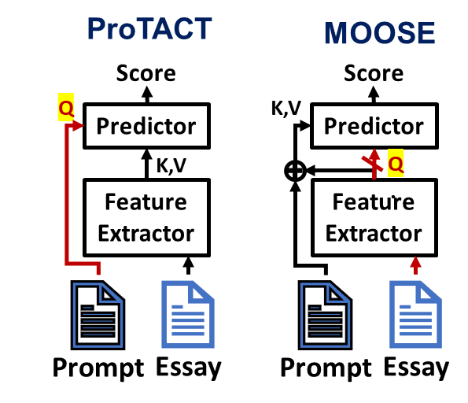
Novelty 1: Essay as Query
ProTACT (SOTA):
Treat the prompt as the query
Evaluate essays from the prompt’s perspective to determine whether a given essay is likely to receive a high score under the given prompt.
MOOSE:
Uses the essay as a query to learn essay representation.
To estimate the distribution of the query (essay) over the values (prompt and essay).
Notes:
In this work, MOOSE proposes three innovations
First, we use the essay as the query
In contrast, ProTACT uses the prompt as the query
It like evaluating essays from the prompt’s perspective
to determine whether a given essay is likely to receive a high score
under the given prompt
In our work,
MOOSE Uses the essay as a query to learn essay representation
to estimate the distribution of the query (essay) over the values (prompt and essay).

Slide 7
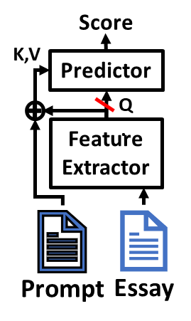
Novelty 2: From Scoring to Scoring Cue Retrieval
Issue:
When training a cross-prompt model, the number of available prompts is severely limited.
Focusing on learning essay representation (query) may lead to overfitting on seen prompts.
Solution:
Apply a stop-gradient operation to the query, preventing its representation from being updated during backpropagation.
The fixed query serves as a stable anchor for retrieving relevant scoring cues.
Notes:
Second, we reformate the task from scoring to cue retrieval.
The motivation is,
When training a cross-prompt model, the number of available prompts is severely limited.
If we focus too much on learning essay representation (query), the model may overfit to the seen prompts.
To address this, MOOSE applies a stop-gradient operation to the query, so it prevents the representation from being updated during backpropagation.
This fixed query representation serves as a stable anchor for retrieving relevant scoring cues.

Slide 8
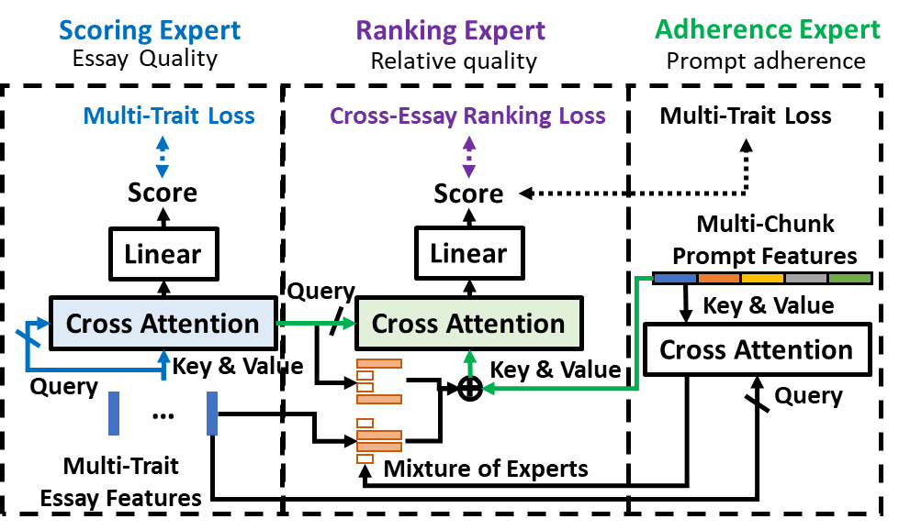
Novelty 3: Mixture of Ordered Scoring Experts
Essay quality: Essay as Queries + trait similarity loss function (Do et al., 2023) + MSE
Relative quality: pairwise ranking loss function
Prompt adherence:
estimate the probability of essay on joint distribution of multi-trait essay representations and prompt features.
The multi-chunk BERT features extracted from the prompt are concatenated with the key and value of cross attention layer.
The model then examines the degree to which the prompt value is attended, identifying potential off-topic situations.
Notes:
Third, Mixture of Ordered Scoring Experts
It combines two ideas:
one is Ordered Scoring Experts
we design three experts:
Scoring Expert – evaluates the essay quality.
It uses cross-attention over multi-trait essay features and
additionally includes a multi-trait loss.
Ranking Expert – compares the relative quality of essays.
- it use the pairwise ranking loss to compare the relative quality of multiple essays.
Adherence Expert – measures how well the essay responds to the prompt.
It computes cross-attention with the essay as the query, and the prompt as key and value.
These three experts work together to simulate how a teacher first score, then compare, and finally check prompt relevance.

Slide 9
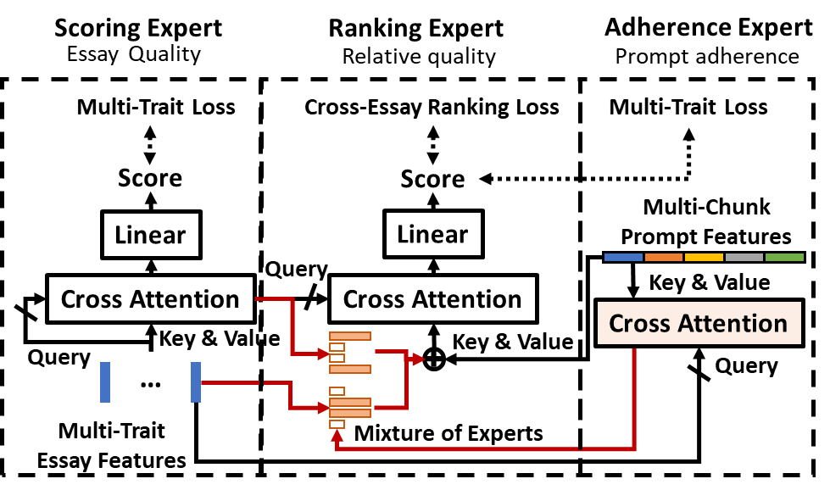
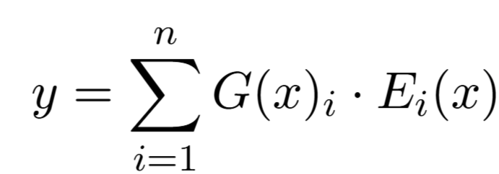


Novelty 3: Mixture of Ordered Scoring Experts
Gate
Notes:
Next, we focus on how MOOSE selects the information for evaluating each trait.
So, we design a Mixture of Experts (MoE) mechanism, which dynamically decides whether to use information from the original essay or the refined features generated by the scoring expert.
And, here the adherence expert acts as a gating function between the two expert networks, controlling how much information is passed from each.
This dynamic selection allows MOOSE to choose the most relevant scoring cues for each trait.
MoE: 因為每個trait 應該由不同專家來決定，應該要看重不同類型的特徵 (learning cue)
原始的trait
還是被scoring exper調整後的Trait
是要看哪一個
Here, we have one infromat consider two expert networks:
One expert network comes from the multi-trait essay features.
The other is a refined essay representation learned from the scoring expert
Next, the adherence expert serves as the gate function for the two expert networks.
The output concate the prompt feature and the ranking expert is dynamic determines to use original features or refined ones.
Then, the adherence expert acts as a gating function,
deciding how to combine these two expert representations.
Finally, the output — which also concatenates the prompt features — is passed to the ranking expert,

Slide 10
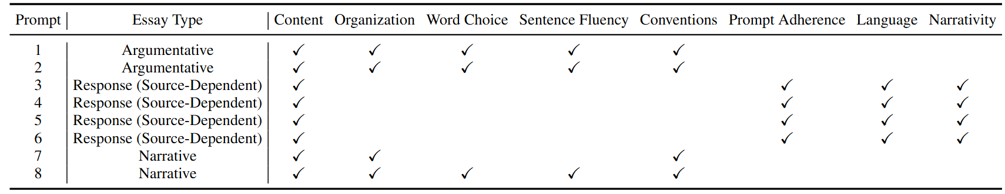
Experiment settings
Dataset: ~13,000 essays from ASAP++ (Mathias & Bhattacharyya, LREC 2018)
Cross-prompt setting:
Leave-one-prompt-out
Train on 7 prompts, test on 1 unseen prompt
Evaluation metric:
Quadratic Weighted Kappa (QWK)
Notes:
Now, let’s move on to the experimental setup.
We evaluate our model on ASAP++, a widely used benchmark for cross-prompt trait scoring. It includes eight prompts and covers three essay types: argumentative, response, and narrative.
Each essay type is associated with different scoring traits. We adopt a leave-one-prompt-out setting, where we train on seven prompts and test on the unseen prompt."

Slide 11
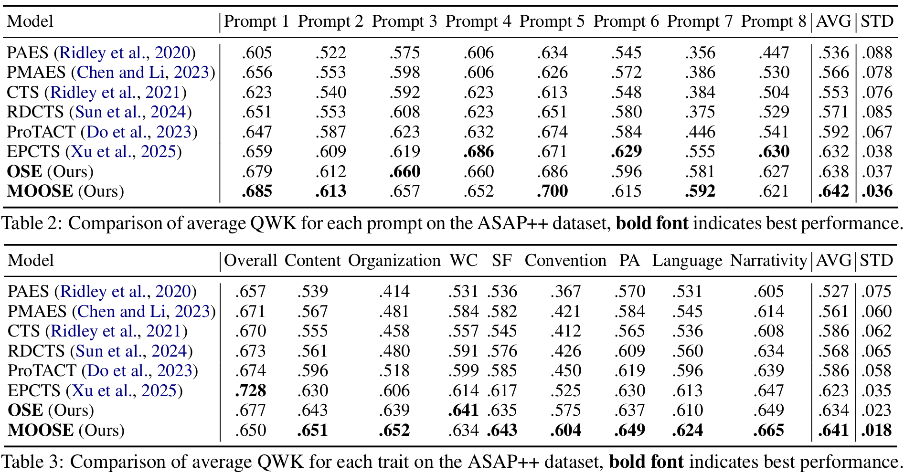

Comparisons with State-of-The-Arts
LLMs-based
LLMs-based
$$↓ \text{\sim 50\%}$$
Notes:
Compared to other state-of-the-art models, MOOSE achieves the best performance across all prompts and traits.
particularly, MOOSE has the lowest standard deviation (STD),
and performs especially well on the 'convention' trait, It shows a clear improvement over prior work.

Slide 12
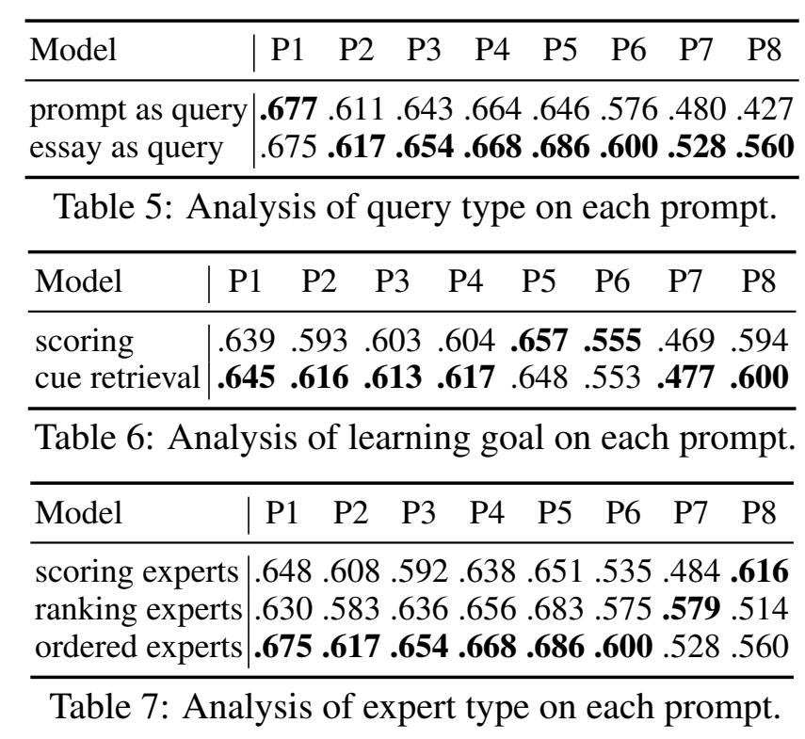
Analysis of cross-prompt essay scoring
Using essay as query strongly improves the performance via estimating distribution of essay over prompt and essay.
Reformulating learning goal to cue retrieval makes the model more robust on the unseen prompts.
The ordered experts get outstanding performance on essay scoring by imitating scoring process of human raters, from holistic evaluation to ranking and then prompt adherence.
scoring experts: multi-trait loss, multi-trait loss
ranking experts: multi-trait loss + ranking loss, multi-trait loss + ranking loss
ordered experts: multi-trait loss, multi-trait loss + ranking loss
Notes:
We further analyze the proposed components( of MOOSE on cross-prompt scoring):
As you can see,
Using essay as query
It strongly improves the performance
Since it estimates distribution of essay over prompt and essay.
Reformulating the task from scoing to cue retrieval
It makes the model more robust on the unseen prompts.
The ordered experts get best performance on essay scoring by imitating human raters
from holistic evaluation to ranking and then prompt adherence.

Slide 13
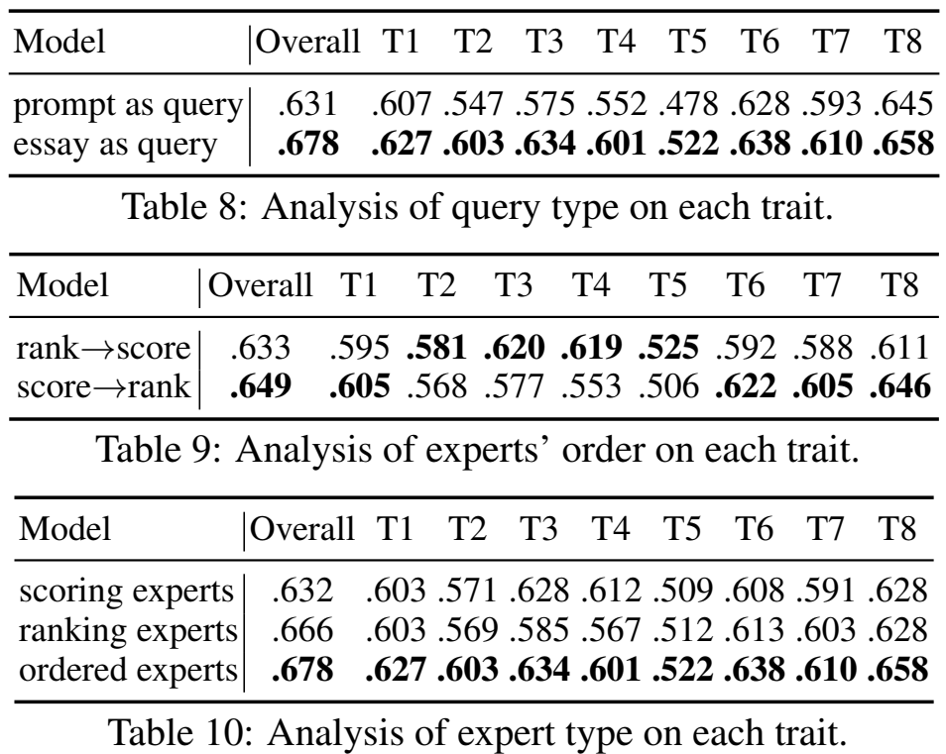
Analysis of trait scoring
Essay-as-query increase scoring ability in all of the traits.
The effect of expert ordering:
rank → score: argumentative prompts on Organization, Word Choice, Sentence Fluency, Convention
score → rank: response prompts on Prompt Adherence, Language, and Narrativity.
Ordered Score Experts achieve the best results for all traits, confirming that imitates the human scoring process is a promising strategy.
T1: Content
T2: Organization
T3: Word choice
T4: Sentence Fluency
T5: Convention
T6: Prompt adherence
T7: Language
T8: Narrativity
Notes:
When analyzing trait-specific scoring, we observe consistent improvements from using essay-as-query and ordered experts.
Here we have one finding,
that is the effect of expert ordering.
For argumentative prompts, the model benefits more from ranking essays first, since traits like organization and word choice often involve comparing essays.
In contrast, for response prompts, which refer to a source article, it's more effective to score the essay first, and then apply ranking later.

Slide 14
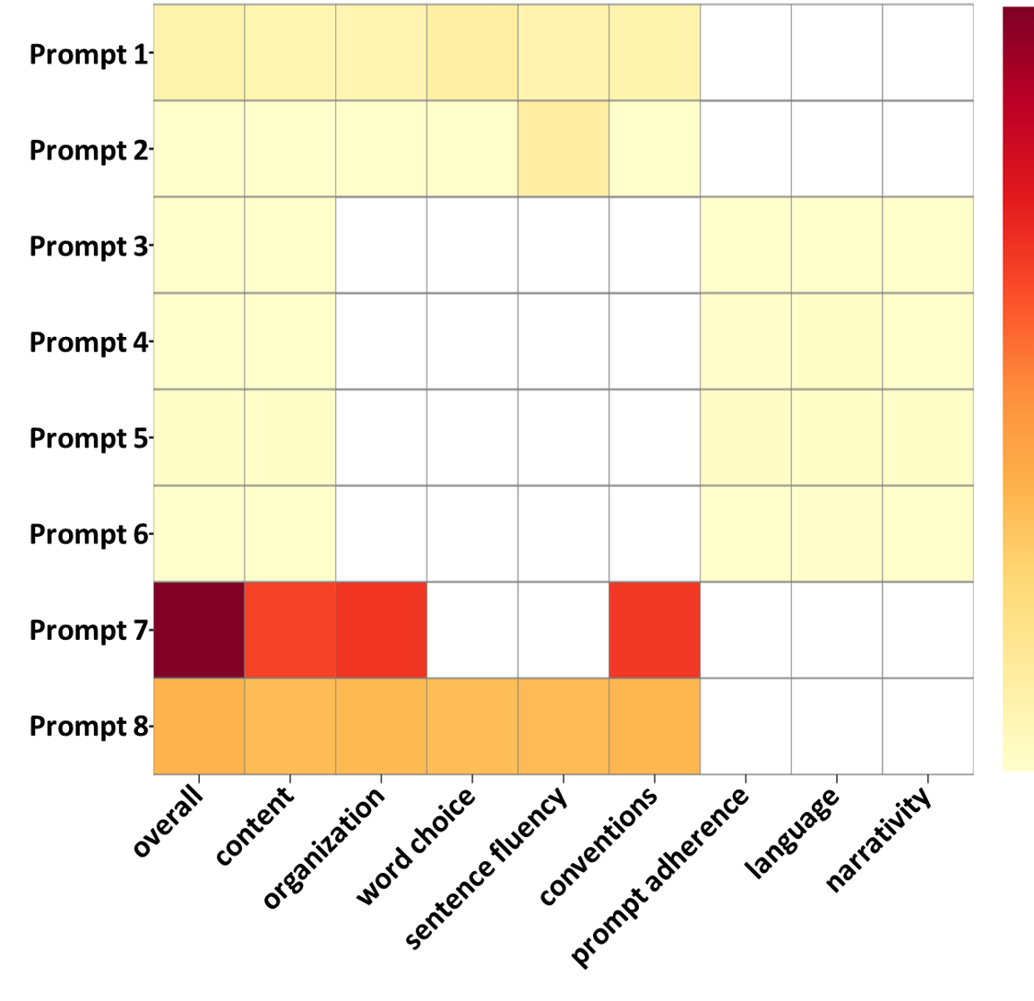
Visualization on MoE gating
Prefer features refined by scoring expert
Narrative prompts (P7, P8):
Prefer refined feature from scoring expert
require high-level semantic features (open-ended prompt).
Response prompt (P3~P6):
Select original multi-trait essay features:
rely on original essay features (source-focused).
Argumentative prompt (P1, P2):
Moderate preference for refined features
support opinions; need semantic cues sometimes
Prefer multi-trait essay features
Notes:
We Visualize on gates of MoE.
As you can see, trait scoring for different prompt types considers different information.
For example, Narrative prompts prefer refined feature since prompt type is open-ended and it require high-level semantic features
Response prompt considers original multi-trait essay features since it reply on original essay more.

Slide 15

Conclusion
MOOSE imitates the scoring process of human experts,
a scoring expert to assess the inherent quality of the essay,
a ranking expert to compare relative quality across different essays,
an adherence expert to measure the relation between the essay-prompt pair.
We introduce essay query, query detach, and MoE techniques, which enable MOOSE to capture fine-grained features and focus on retrieving useful scoring cues.
MOOSE achieves impressive performance on the ASAP++ cross-prompt essay trait scoring task, surpassing current SOTA built on LLMs.
https://antslabtw.github.io/MOOSE/
Notes:
To conclude, in this paper, we propose MOOSE —
imitates the human scoring process
by evaluating essay quality, comparing relative quality, and assessing prompt adherence.
We introduce three key techniques: essay-as-query, query detachment, and the Mixture of Experts (MoE) mechanism. These enable MOOSE to focus on retrieving the most relevant scoring cues for each trait.
Experimental results show that MOOSE achieves state-of-the-art performance in trait scoring, outperforming previous work, including that built on large language models.
Thank you!

